Slide 1
Qt Design Studio An Introduction
Thomas Hartmann
Senior Manager
The Qt Company
10.06.2021
Qt Design Studio an Introduction

Slide 2
Today’s Speaker
Thomas Hartmann Senior R&D Manager
Lead Developer for Qt Design Studio
Thomas.Hartmann@qt.io

Slide 3
About this talk
Introduction
Qt Design Studio
Demo
Behind the scenes of Qt Design Studio
Q & A

Slide 4
What is Qt Design Studio?​
Qt’s dedicated Design Tool ​
For creating UI & UX​
In 2D & 3D​
Using QML​
Qt Design Studio is a Qt Creator adjusted and optimized for designing QML and Qt Quick
Qt Design Studio 2.1
commercial license
free community version
Place for date

Slide 5
What can I do with Qt Design Studio?
Develop UI designs in WYSIWYG editor
Create timeline animations​
Define UI logic with states​ and bindings
Create custom controls​
Import Designs and Assets from other Design Tools, such as:​
Photoshop, Sketch and Figma for 2D Design​
Maya, Blender & others for 3D Design
Turn designs and assets into working QML​
Deploy, run and profile on target hardware

Slide 6
Qt Design Studio 2.1
Key Features
Bridges for importing designs
Visual 2D and text editor
Visual 3D scene editor
Improved flow editor
State transition editor
Dynamic and scalable layouts
Ready-made and reusable UI components
Timeline-based animations
Built-in and customizable visual effects
Live Preview designs on devices

Slide 7
Fast and iterative release approach
December 2018
First Release
September 2020
December 2020
April 2021
Current Release
September 2021
Next Release
Qt Design Studio 1.0
Qt Design Studio 1.6
Improved bindings and connections
Transitions
Annotations
Qt Design Studio 2.0
Figma Import (TP)
UX Improvements
Qt Design Studio 2.1
Figma Import (full support)
New Item Library
Upcoming Release
Full Qt 6 support
UX Improvements
Property Editor update

Slide 8
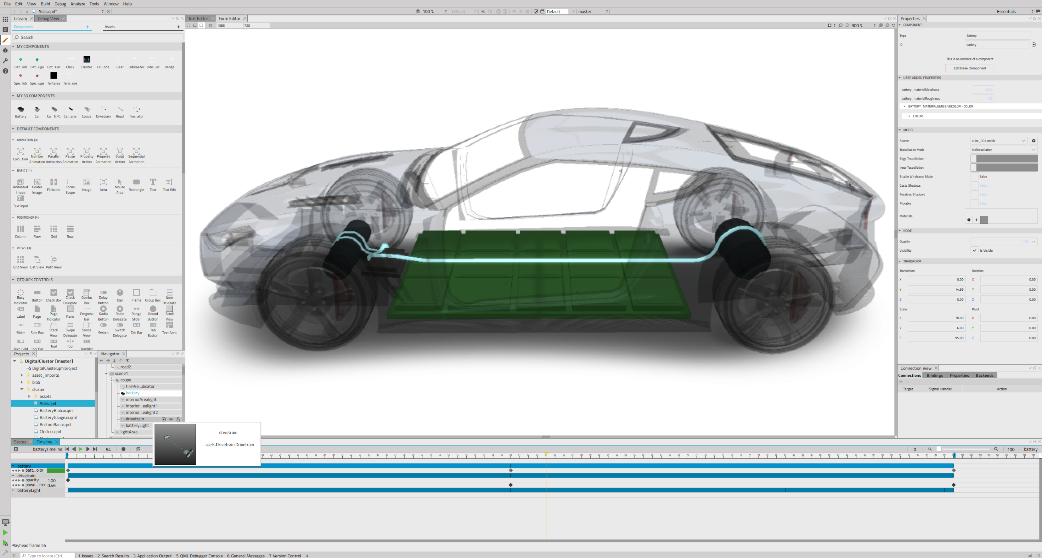
Demo

Slide 9
Behind the Scenes of Qt Design Studio
Using Qt and Qt Quick for cross platform desktop applications
We are porting to Qt 6
Qt Design Studio is available for Windows, macOS and Linux
Challenges
Graphics drivers especially on Windows
Linux is a very heterogeneous environment (officially we support Ubuntu 20.04 (latest LTS))

Slide 10
Customized version of Qt Creator
No fork of Qt Creator
Qt Design Studio is a branded Qt Creator
Different packaging of Qt Design Studio
Qt Design Studio comes with a specific Qt version for the runtime
Qt Design Studio comes with custom components qt-labs/qtquickdesigner-components
Some parts like the Qt Bridges are closed source

Slide 11
Qt Advanced Docking System
Contributed to Qt/Qt Creator by Uwe Kindler
GNU Lesser General Public License, version 2
https://marketplace.qt.io/products/advanced-docking-system
https://github.com/githubuser0xFFFF/Qt-Advanced-Docking-System
Clear visualization of drop targets
Docking everywhere - no central widget
Perspectives for fast switching of the complete main window layout
Qt Creator contains a fork we maintain

Slide 12
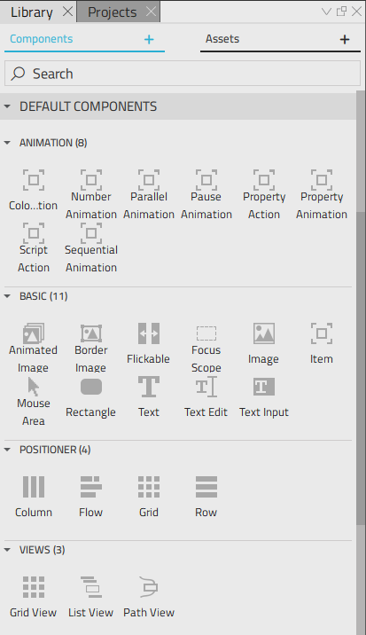
Using Qt Quick for desktop applications
We use Qt Quick for the GUI
Welcome Screen and Splash Screen
Property Editor
Item Library
States Editor

Slide 13
Welcome Screen and Splash Screen
Simple enough to be developed in Qt Design Studio
Can be maintained and adjusted by designers
Pure QML
The C++ backend is easily mocked with QML

Slide 14
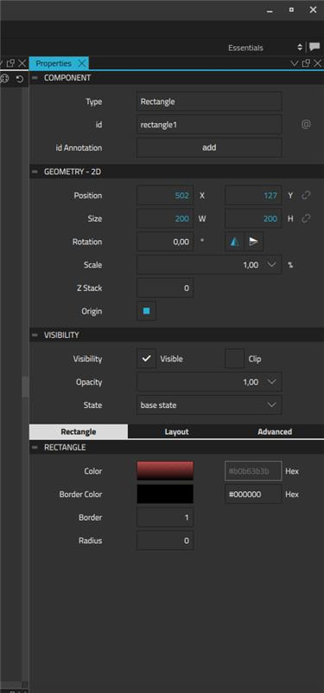
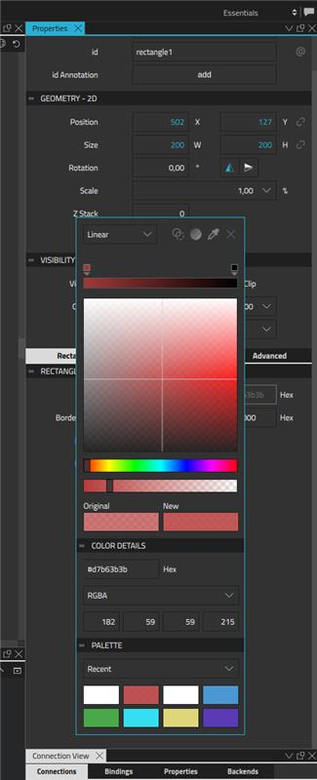
Studio Controls
Customized Qt Quick Controls 2 for the property editor
Heavily customized Qt Quick Controls 2
Theming using constants and colors
All sizes and colors are defined by theming
Studio Controls are resizable
Modern UX like dragging on Spin boxes
Hiding of clutter, showing sub controls on mouse hover
The Studio Controls are part of Qt Creator

Slide 15
Advantages of using Qt Quick in the front end
Easy to customize look and feel
Easy to implement modern and advanced UX
Qt Design Studio can be used for the front-end
Designer can take full responsibility
Hot reloading QML allows very fast feedback cycles
The property editor can be extended by ‘external’ QML files shipped with QML modules

Slide 16
Challenges of using Qt Quick in the front end
Bindings between C++ and QML require overhead and boiler plate code
Developers have to be experienced in C++ and QML/Qt Quick
Qt Quick is not as mature as Qwidgets for desktop development
Depends on 3D acceleration which can create issues
High complexity

Slide 17
Google Crashpad
Google Crashpad Integration to collect stack traces from crashes
Opt-in since confidential information is possibly shared as part of the crash dump
Works with all supported platforms
https://chromium.googlesource.com/crashpad/crashpad/+/refs/heads/main/doc/overview_design.md
We use Sentry as the backend service https://sentry.io/security/

Slide 18
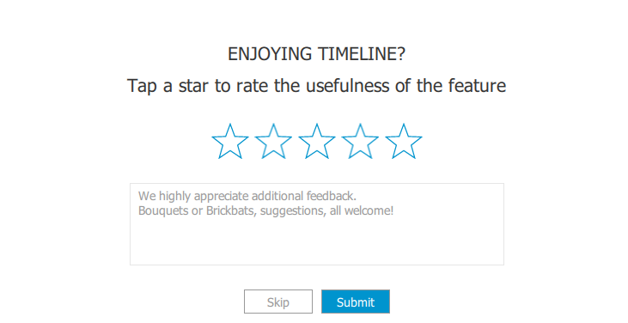
Telemetry
Qt Design Studio uses a Telemetry Plugin to collect user data
Opt-in
Fully transparent
The Telemetry Plugin is using the Open Source library KUserFeedback.
https://api.kde.org/frameworks/kuserfeedback/html/index.html

Slide 19
Trying out Qt Design Studio
https://download.qt.io/official_releases/qtdesignstudio/2.1.0/
Download Qt Design Studio using the Qt Online Installer

Slide 20
Thank you!
Learn more at www.resources.qt.io ​
Contact us at www.qt.io/contact-us/ ​
Try for Free at www.qt.io/download/ ​
Follow us: ​
Twitter: @Qtproject​
Facebook: /qt/ ​
Linkedin: /company/theqtcompany/​
Youtube: /QtStudios/

