Slide 1
Kalk – My very first OSC Project
Rohan Asokan

Slide 2
I am
Rohan Asokan
A student developer from India

Slide 3
My experience with KDE so far
Setting up my environment for over 3 months ;( (realized Kali isn't the OS for me)
Assigning myself to an issue and forgetting about it. Am sorry ;(
Participating in Season of KDE

Slide 4
Season of KDE '21 - Kalk
Kalk is a powerful light-weight cross platform calculator built on the Kirigami Framework.

Slide 5
What I planned for?
Some additions to the already halfway done scientific calculation functions, like sin, cos, tan, etc.
Introduction of a new binary calculation module
Look into how a date calculation will fit in.

Slide 6
Additions to the scientific calculations module
Found the codebase very overwhelming, though it was quite small.
But, figured a way to efficiently look through code.
Resulted in my very first MR with KDE.

Slide 7
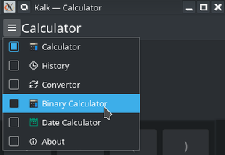
Programmer mode / Binary calculation Module
Took me over a month to realize how this should be done.
Also took me over a month to realize I can talk to my mentor about it.

Slide 8
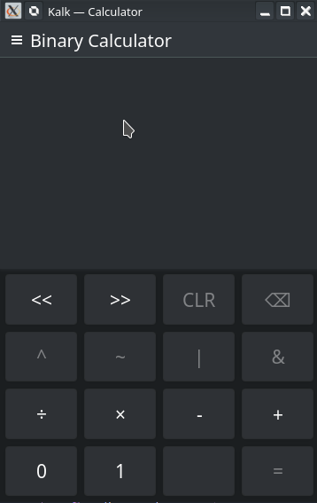
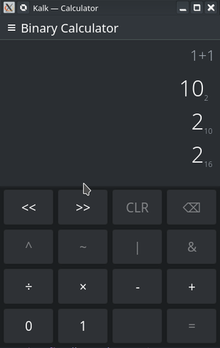
Binary Calculator UI

Slide 9
Port to KNumber
Infinite Precision!!!!!!!

Slide 10
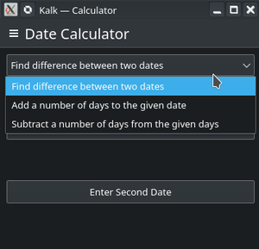
Designing a Date calculation module

Slide 11
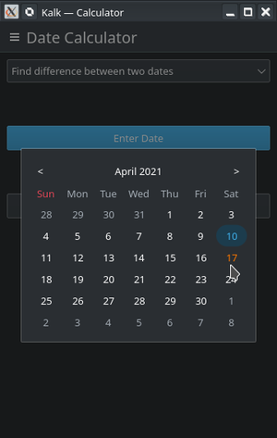
More UI screenshots

Slide 12
My Takeaways from the whole experience
Its natural to be scared of a large codebase, approaching it modularly is the way to go about it.
Talk and discuss with the people already working on the project – they could at the very least point you in the right direction even if they can't tell you the ins and outs of doing it (they are busy people too ;)).
Always feel free to ask doubts – they might seem stupid to you, but its worth the try. What's the worst that could happen?
But, this is also to say that do look into things yourself and only when you cant figure things out, only then, it becomes a doubt;)

Slide 13
Thanks to everyone!!!
Thank you Valorie Zimmerman for letting me know about SoK.
Thank you Han Young for helping me out and answering all my stupid questions and being an amazing mentor.
Thanks to the entire KDE community for being what it is!! :)

Slide 14
Thank You!!! Have a great day!

Slide 15
Some links
https://community.kde.org/SoK/2021/StatusReport/Rohan_Asokan
GitLab - https://invent.kde.org/arenagrenade
GitHub - https://github.com/ArenaGrenade
LinkedIn - https://www.linkedin.com/in/rohan-asokan/
Email – rohan.asokan@students.iiit.ac.in
Website - https://arenagrenade.github.io/portfolio/ (Under construction, so consider not opening it on a low-end device, has some 3d shaders)

