Slide 1
The next generation of ‘
Lars Knoll, Qt Chief Architect, The Qt Company
23. June, 2021

Slide 2
Simplify development and maintenance of cross-platform applications and embedded devices

Slide 3
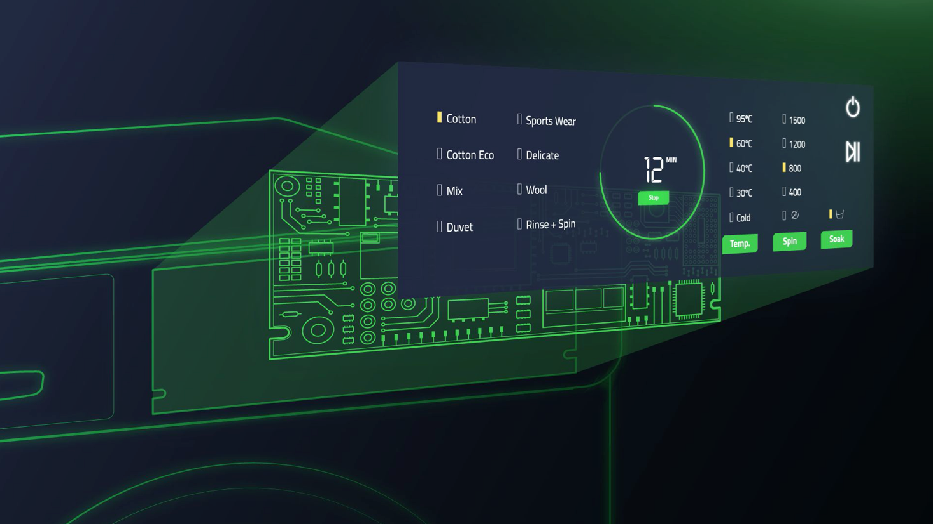
Qt 6

Slide 4
Goals
> Fix architectural limitations in Qt 5
> Improved performance
> House cleaning
> Package management support
> Smaller and modular core product
> Compatibility with Qt 5

Slide 5
Core Values
> Cross platform
> Maintainability and compatibility
> Scalable
> Intuitive and easy to use
> Documentation
> Tooling
Notes:
‘Qt 6 aims to adjust our product to new market demands while keeping those values at the heart of what we’re doing’

Slide 6
Focus on cleaning up our code base and architecture, not on new features

Slide 7
Compatibility
Mostly source compatible with Qt 5
Some porting required
Requires some changes to source code
Requires a recompile
Deprecated functionality has been removed
Those changes prepare us for the years to come

Slide 8
Architectural changes in Qt 6

Slide 9
Notes:
C++ has changed a lot over the last years. While we had to base Qt 5.0 on C++98, we can now rely on C++17 for Qt 6.
Leads to more readable code: structured bindings, init statement in if(), constexpr if, improved template argument deduction rules

Slide 10
Containers
Unified QList and QVector
Fixed implementation issues in QList
QVector an alias to QList
64bit support: qsizetype
Rewritten QHash and QMap
Fill API gaps towards std containers
Move operations & emplace
Ranges & initializer lists

Slide 11
Performance: Hash<int64_t, int64_t>
Measurements done using https://github.com/Tessil/hash-table-shootout.git

Slide 12
Unicode & String classes
All text handling Unicode based
Source code is UTF-8
Clean up string related classes
Consistent set
QUtf8StringView
Move legacy encoding support out of Qt Core

Slide 13
Bindings
Extend our property system with the concept of bindings
Bring the best part of QML to all of Qt
And make it available from C++
Seamless integration with QObject
Simple extension of the existing property system
New QProperty class
Support bindable properties outside of QObject

Slide 14
import QtQuick
Rectangle {
property int width
property int height: width
property int border: height/10
}

Slide 15
struct Rectangle {
QProperty<int> width;
QProperty<int> height;
QProperty<int> border;
Rectangle() {
height.setBinding(Qt::makePropertyBinding(width));
border.setBinding([this]() {
return height / 10;
}
}
};

Slide 16
Graphics Architecture
Qt Tools
Qt Design Studio
Qt Creator
Qt Quick (2D + 3D)
Qt Frameworks
Qt Quick Scene Graph
Qt Shader Tools
RHI
Platform API
OpenGL (ES)
Vulkan
Metal
Direct 3D 11

Slide 17
Rendering Hardware Interface
Abstraction layer for 3D graphics APIs
OpenGL, Metal, Direct 3D 11, Vulkan
Abstracts graphical objects
Materials, Meshes, Shaders, etc.
Internal API tuned towards the needs of Qt
Integrated with Qt Platform and Window system abstraction layers
Qt Quick and Qt Quick 3D are fully ported to RHI

Slide 18
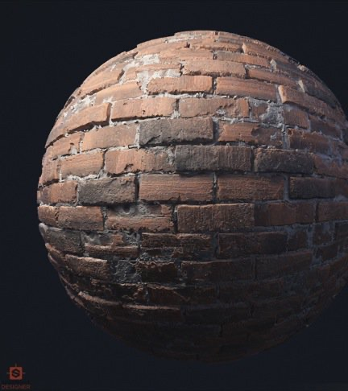
Qt Shader Tools
Support for cross platform shaders
Write shader once
Recompile to all graphics APIs
Support for build time and runtime shader compilation

Slide 19
Qt 6 uses the native graphics API of each operating system

Slide 20
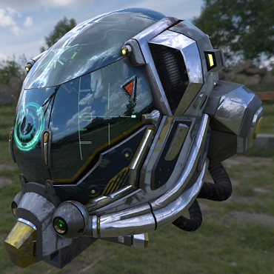
Qt Quick 3D
Efficiently combine 2D and 3D in one scene
One scene graph and optimized scene graph
PBR support
Materials look like they are designed
Support for GlTF2
Import 3D models
Supports base spec
Supports most of the common extensions

Slide 21
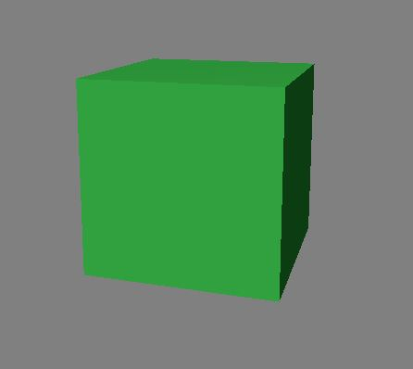
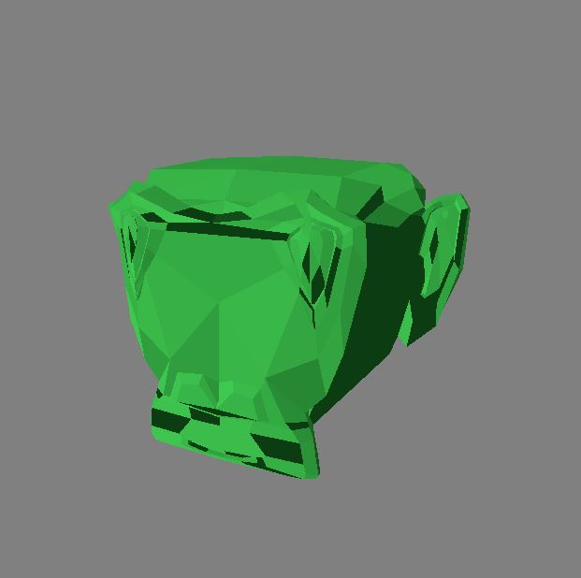
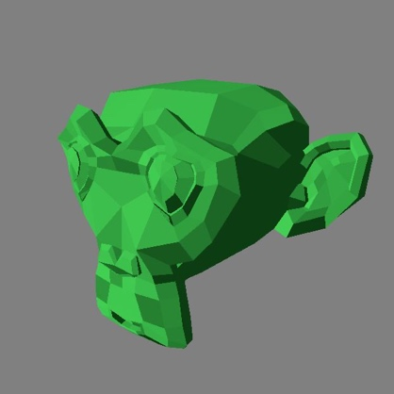
Advanced features
Qt Quick 3D
3D particle system
Create those WOW effects on the UI.
Use 3D game style UI transitions and animations.
Create realistic weather animations.
Instanced rendering
Draw large amounts of objects with only few instructions.
Mesh morphing animations
Smooth and easy transitions of a model
Connect to state changes of the UI
Notes:
Before Qt 6, Qt did not have proper 3D particle system. Instead of doing a fake one with shaders and fixed camera locations, we wanted to go along the lines of a real game engine 3d particle system. And now we have. This enables for example to create realistic weather effects just to mention an example.
With particle system, users can create nice eyecandy, explosions, glitter, great looking UI animations and such - without any shader coding.
Particle models can be almost anything drawn on the screen, 2D , 3D models, videoframes

Slide 22
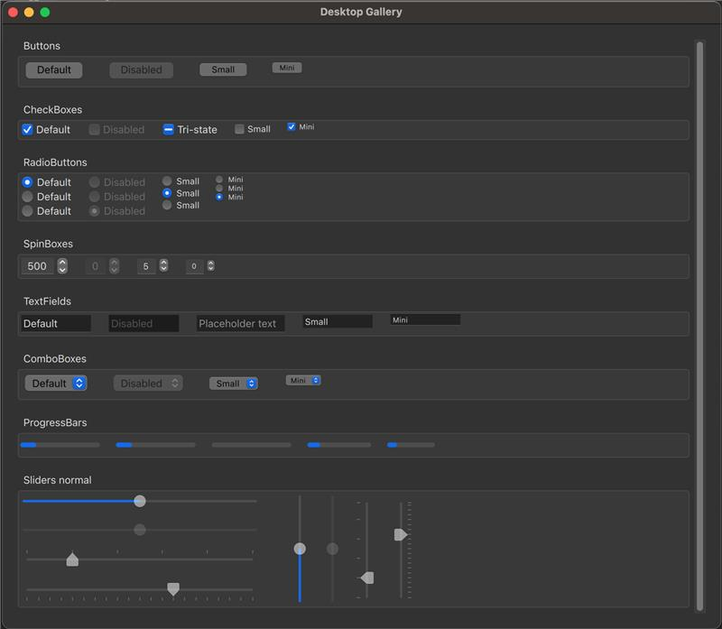
Desktop style for Quick Controls
Native look and feel for
Qt Quick Controls on
macOS, Windows and
Linux

Slide 23
Unified Pointer events
Unified handling of mouse, touch and tablet events
One common base class: QPointerEvent
Specializations for mouse, touch and tablet events
Common data
Tracking of input device and history of event points
Resolves recurring issues with touch handling in complex controls
e.g. touch enabled controls inside Flickable

Slide 24
Developer Experience / Qt Creator

Slide 25
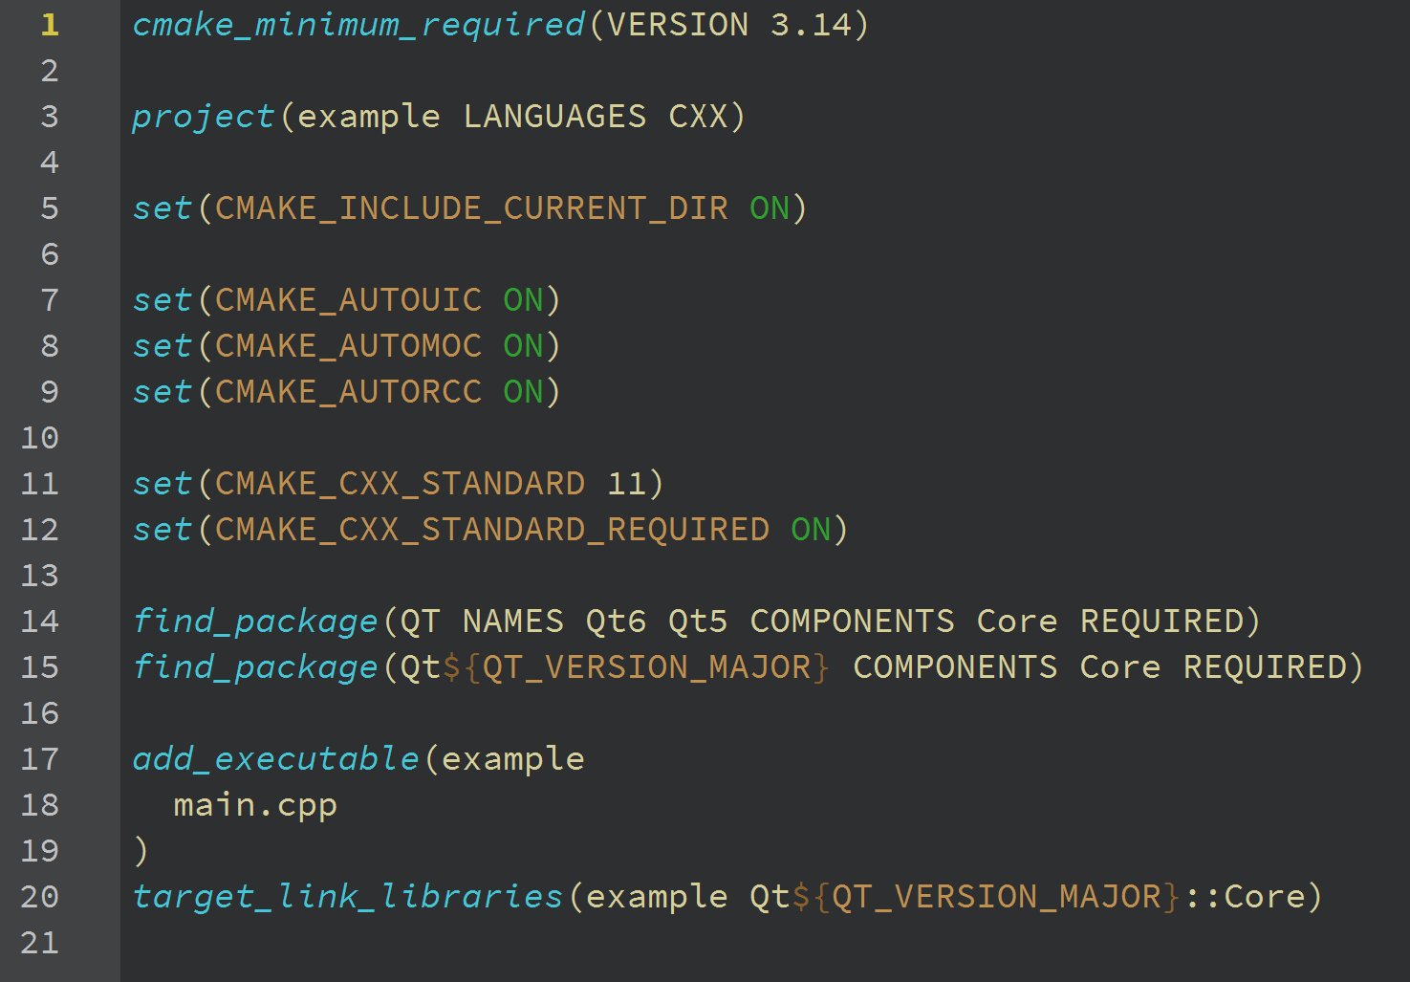
Developer Tooling Fully Supporting Qt 6
Wizards generate Qt 6 compliant projects
Inspect Qt 6 types in the debugger
Editor knows the new QML and C++ language features
Access Qt 6 documentation and examples

Slide 26
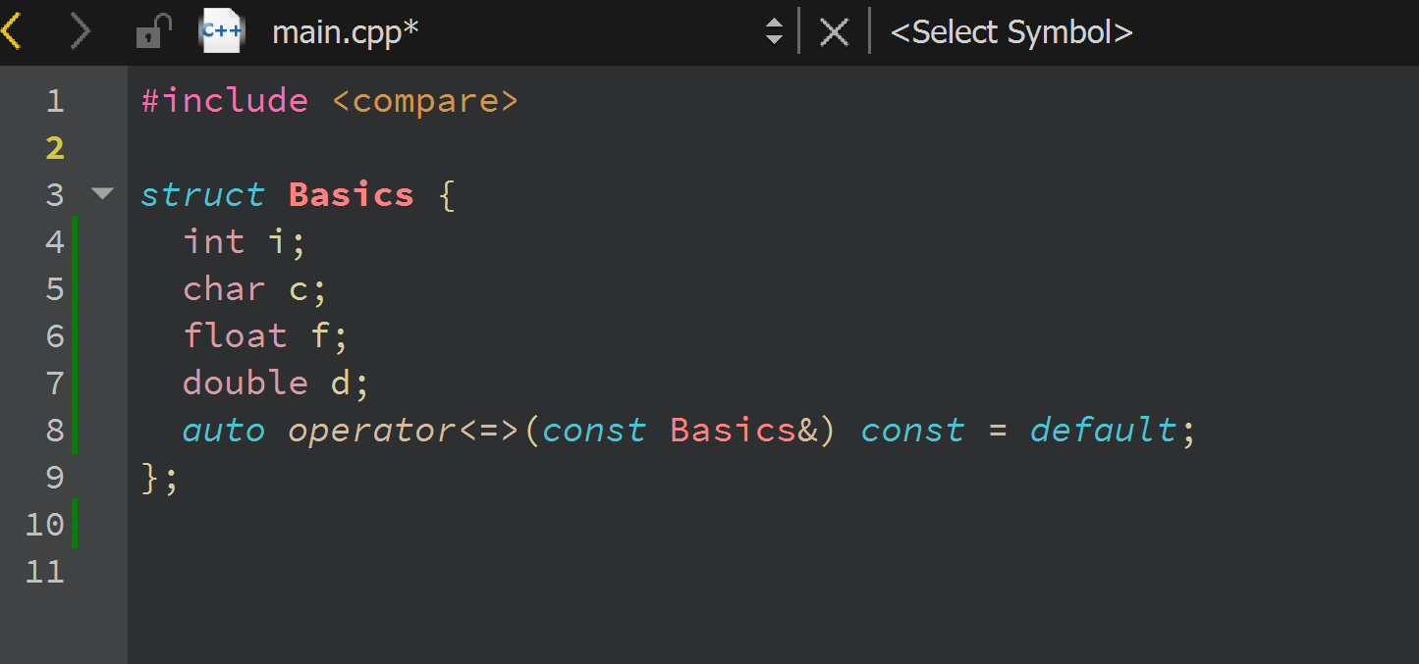
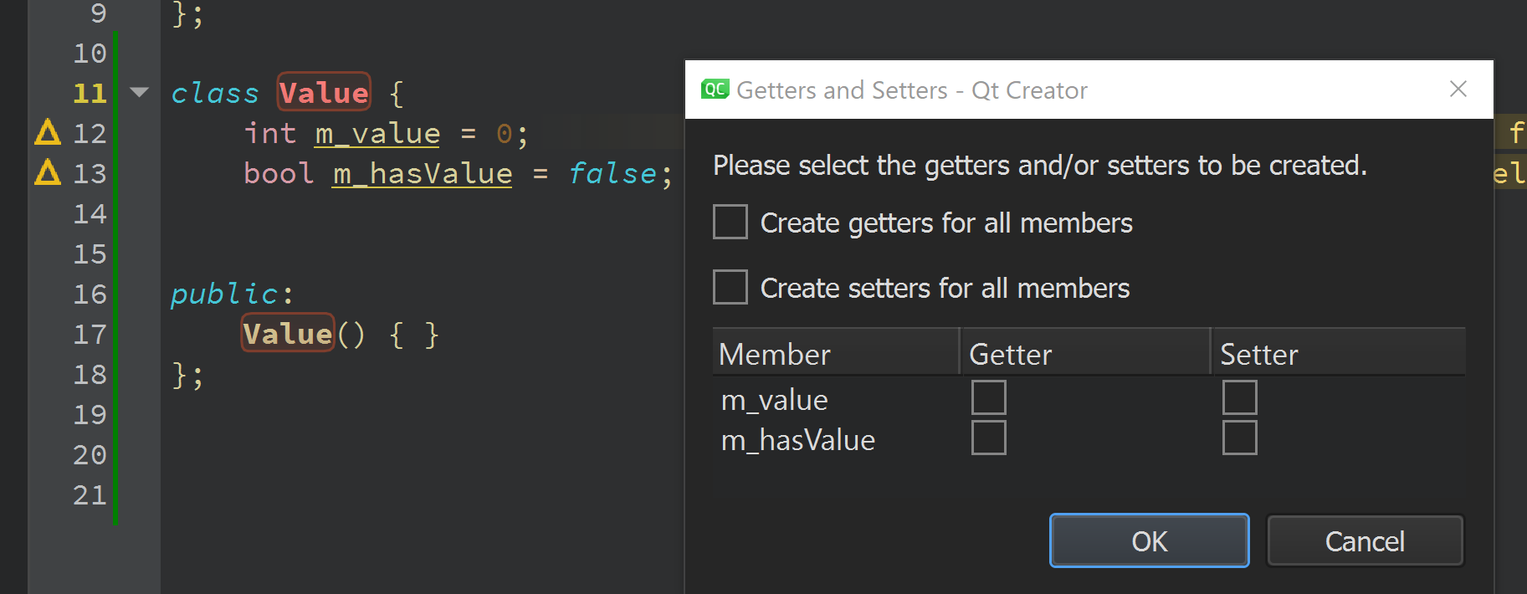
New Tools for C++ Development
New and improved refactoring operations
Clang code model to Clang 11
Tighter integration of Clazy and Clang-Tidy
Multiple improvements to C++ development throughout
Vastly improved cmake support

Slide 27
Designer Experience / Qt Design Studio

Slide 28
Unified 2D and 3D Design Tool
Qt design studio 2.0
Create 3D UIs with Qt Quick 3D in addition to traditional 2D UI design
Import designs from favorite 2D and 3D tools
Visual 3D editor to work with the scenes
Define keyframe-based timeline animations
Assign 3D effects
Mix 2D and 3D content seamlessly inside your application
Import
Notes:
Since version 1.5, Qt Design studio has supported also creation of 3D UIs in addition to traditional 2D UIs
We have utilized our experience in Qt 3D Studio to bring the best 3D concepts to Qt Design Studio.
The result is a comprehensive integrated 3D tool for composing and editing 3D scenes
You can import files you created using 3D graphics applications and exported to several widely-used formats, such as .blend, .dae, .fbx, .glb, .or gltf,
Qt Design Studio’ s has a 3D editor which enables creating and composing scenes and visually edit with, for example, models, textures, cameras and lights.
You can also add effects like Emboss, Brush Stokes, Gaussian Blur and Motion Blur to a Qt Quick 3D view by using drag and drop.The properties of these effects can then be edited and even animated
The unified tool enables mixing of 2D and 3D content seamlessly
It also makes learning and using of the tool easier as both sides are working similarly and uses similar kind of concepts such as components, timeline animations, bindings and states

Slide 29
Qt Design Studio Outlook
Improved interoperability with Qt Creator
Tooling for all Qt Quick 3D features
Particles
Skeletal animations
…
Low code features
Visual programming of UI logic
Shader programming tools
Wireframe tools for 2D shapes and paths
Custom material & effect creation tools
Adobe XD bridge

Slide 30
Beyond Qt 6.1

Slide 31
Porting of most remaining Qt AddOns to Qt 6
Connectivity, Remote Objects,…
Improve on stability and maturity
6.2 as first long-term support release
Development targets match and pass Qt 5 richness
WebAssembly, INTEGRITY, QNX, more embedded HW references, etc
New Qt Multimedia
Easier to use API
Consistent feature set
Qt WebEngine
Decoupled from Qt releases
Faster release cycles
Always based on latest, most secure Chromium
Qt for Python
WHAT‘S MORE?
Content roadmap
Notes:
Qt 6.0 is the start of a long journey.
We focussed on getting the core technology right, leading to some features not being ready with the initial 6.0 release. These modules will now start to receive updates based on the new technical assets, get modernized, and then subsequently added to our product line, matching and exceeding any expectations.
The same applies to platforms not being available in the initial release.
If you have any questions, recommendations, requirements on priorization, please feel free to get in touch with us. We‘re eager to get your feedback.

Slide 32
Supported Modules in Qt 6
Qt 6.0
Qt 6.1
Qt 6.2
Qt Shader Tools
Qt SQL
Qt SVG
Qt Test
Qt UI Tools
Qt Wayland
Qt Wayland Compositor
Qt Widgets
Qt XML
Qt 3D
Qt Image Formats
Qt Network Authorization
M2M package: Qt CoAP
M2M package: Qt MQTT
M2M package: Qt OpcUA
Active Qt
Qt Charts
Qt Data Visualization
Qt Lottie Animation
Qt Quick Dialogs (File dialog)
Qt ScXML
Qt Virtual Keyboard
Qt Bluetooth
Qt Multimedia
Qt NFC
Qt Positioning
Qt Quick Dialogs: Folder, Message Box
Qt Remote Objects
Qt Sensors
Qt SerialBus
Qt SerialPort
Qt WebChannel
Qt WebEngine
Qt WebSockets
Qt WebView
Qt Concurrent
Qt Core
Qt Core Compat
Qt D-Bus
Qt GUI
Qt Help
Qt Network
Qt OpenGL
Qt Print Support
Qt QML
Qt Quick
Qt Quick 3D
Qt Quick Controls
Qt Quick Layouts
Qt Quick Timeline
Qt Quick Widgets
Notes:
Currently 31 essential and add-on modules available with Qt 6.0.
20 add-ons being worked on and coming with Qt 6.1 and Qt 6.2 during 2021.

Slide 33
Platforms
DEVELOPMENT HOSTS AND TARGETS IN QT 6.1
Development Hosts
Windows 10 20H2 (64bit Intel; msvc2019 or mingw81/gcc8.1)
macOS 11 (64bit Intel; XCode 12)
Linux
Ubuntu 20.04 (64bit Intel; gcc9)
CentOS 8.3.2004 (64bit Intel; gcc9)
SLES 15 (SUSE Linux Enterprise Server, 64bit Intel; gcc10)
Open SUSE 15.2 (64bit; gcc10)
Target Environments
Windows 10 20H2 (64 bit Intel)
macOS 10.14, 10.15 and 11
Linux
Desktop
Embedded Linux (Yocto 3.2 Gatesgarth)
Android 21+ runtime, 28 build time
iOS 13+
QNX and INTEGRITY (Tech Preview)
Desktop
Embedded device
Dev host
Phone, tablet
Subset of Qt 5 targets in Qt 6.0/6.1, gradually ramp up and match Qt5 richness in Qt 6.2
Notes:
Qt 6 lifts the minimal requirements for development hosts, yet allowing a wide range of platforms.
All major platforms and distributions are supported as target systems in the initial Qt 6.0 release.
Realtime operating systems (like Blackberry QNX, GreenHills Integrity, Windriver VxWorks,..) will be supported in later Qt 6 releases.

Slide 34
Platforms
DEVELOPMENT HOSTS AND TARGETS IN QT 6.2
Development Hosts
Windows 10 20H2 (64bit Intel; msvc2019 or mingw81/gcc8.1)
macOS 11
Linux
Ubuntu 20.04 (64bit Intel; gcc9)
CentOS 8.3.2004 (64bit Intel; gcc9)
SLES 15 (SUSE Linux Enterprise Server, 64bit Intel; gcc10)
Open SUSE 15.2 (64bit; gcc10)
Target Environments
Windows 10 20H2 (64 bit Intel)
macOS 10.14, 10.15 and 11
Linux
Desktop
Embedded Linux (Yocto 3.2 Gatesgarth)
Android 21+ runtime, 28 build time
iOS 13+
QNX and INTEGRITY
WebAssembly
Desktop
Embedded device
Dev host
Phone, tablet
Notes:
Qt 6 lifts the minimal requirements for development hosts, yet allowing a wide range of platforms.
All major platforms and distributions are supported as target systems in the initial Qt 6.0 release.
Realtime operating systems (like Blackberry QNX, GreenHills Integrity, Windriver VxWorks,..) will be supported in later Qt 6 releases.

Slide 35
Qt 6 Release Schedule
2020 |  | 2021 |  | 2021 |  | 2023 |  | 2022 |  | 2025 |  | 2023
Qt 5.15
June 2020
Qt 5.15 LTS
Until June 2023
Qt 6.0
December 2020
Qt 6.1
May 2021
Qt 6.2
September 2021
Qt 6.2 LTS
Until September 2024
Qt 6.3
March 2022
Qt 6.4
September 2022
Qt 6.5
March 2023
LTS
TODAY

Slide 36
Thank you!
lars.knoll@qt.io
@larsknoll

